Slide 1
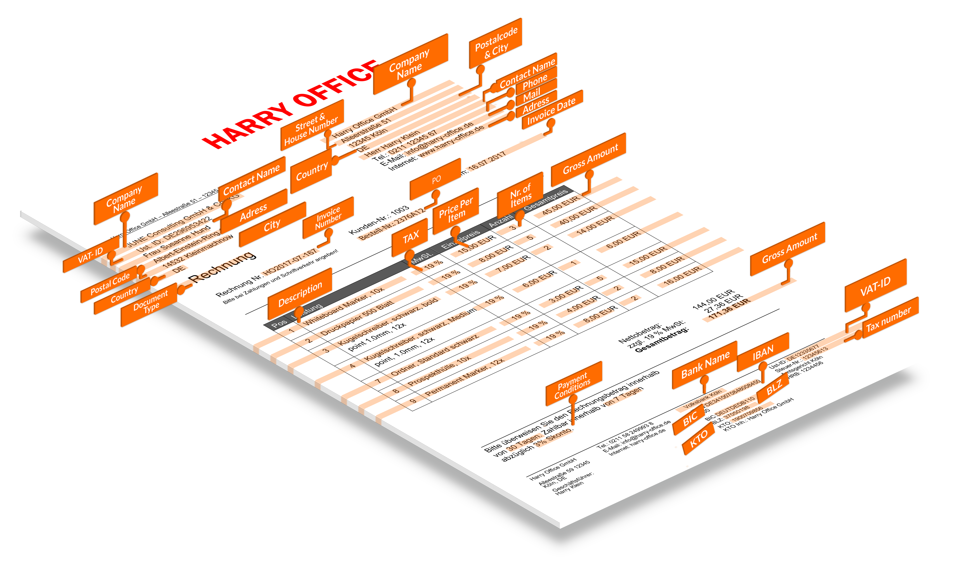
SMACC.io

Slide 2
Korzyści Naszego Rozwiazania
12 days
>5 USD
3 %
- 95 %
-80 %
-65 %
<1 %
1.5 USD
0.5 days
w/o
SMACC
with
SMACC
w/o
SMACC
with
SMACC
w/o
SMACC
with
SMACC
Processing time
per invoice
Processing costs
Per invoice
Error rates
2
Quelle: PWC Study; SMACC customer results

Slide 3








Klienci
3

